Slide 1
DELE CA1 CNN
Done By:
Ryan Yeo
P2214452
DAAA/FT/2B/01

Slide 2
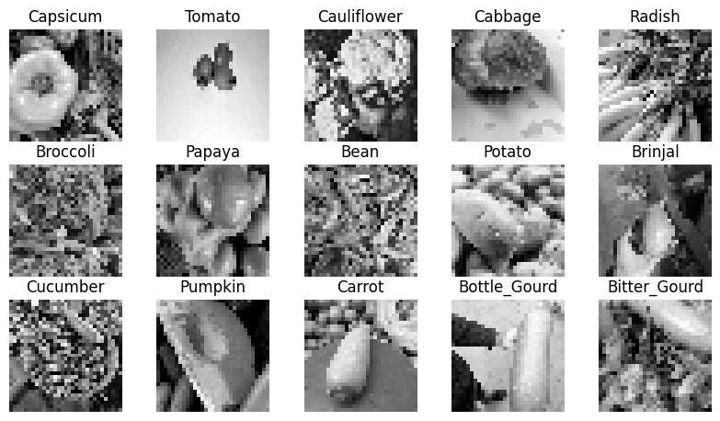
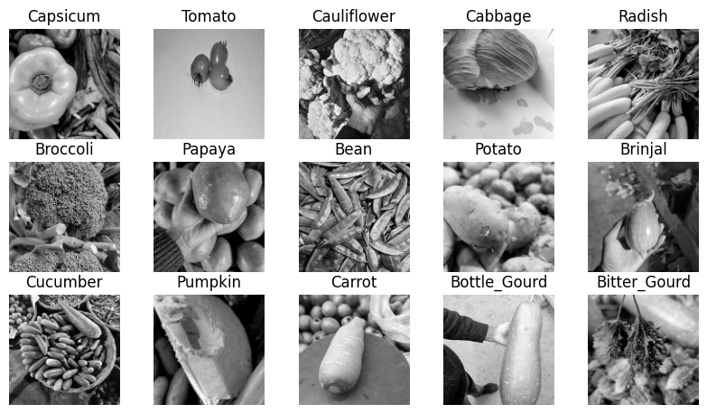
Loading Data
31x31 Images
128x128 Images
Train: Found 9028 files belonging to 15 classes.
Validation: Found 3000 files belonging to 15 classes.
Test: Found 3000 files belonging to 15 classes.

Slide 3
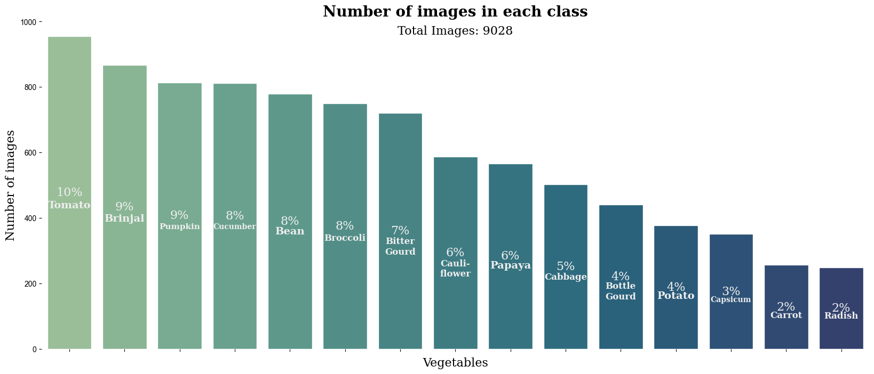
2. EDA
Class Imbalance

Slide 4
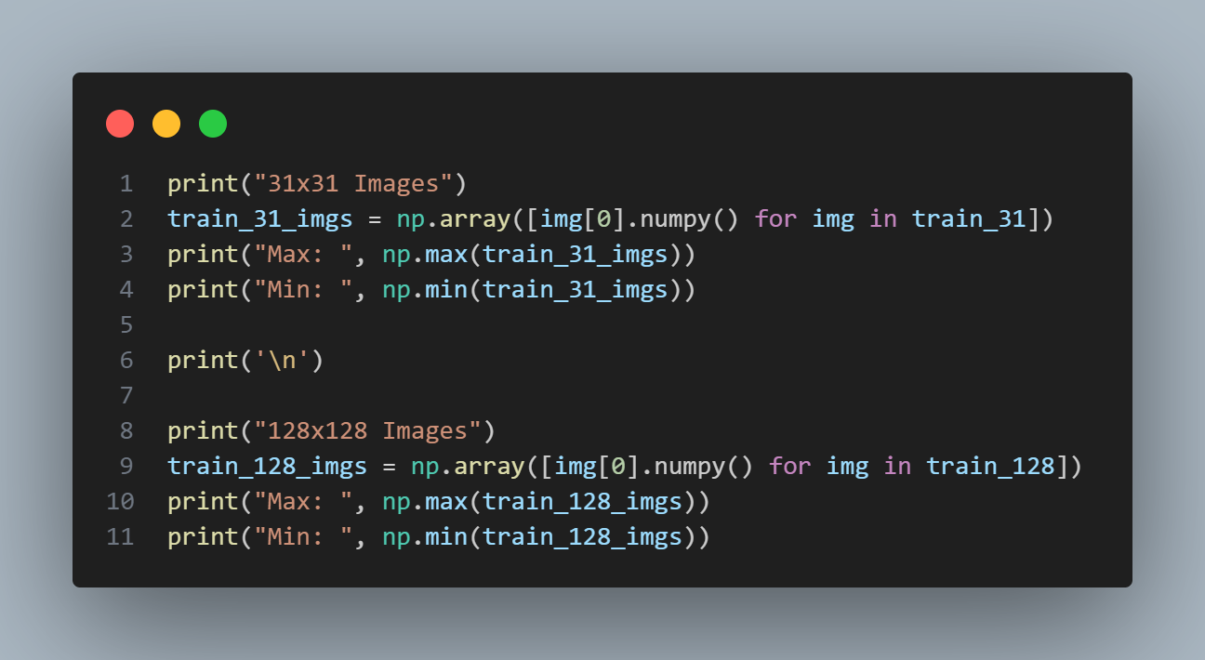
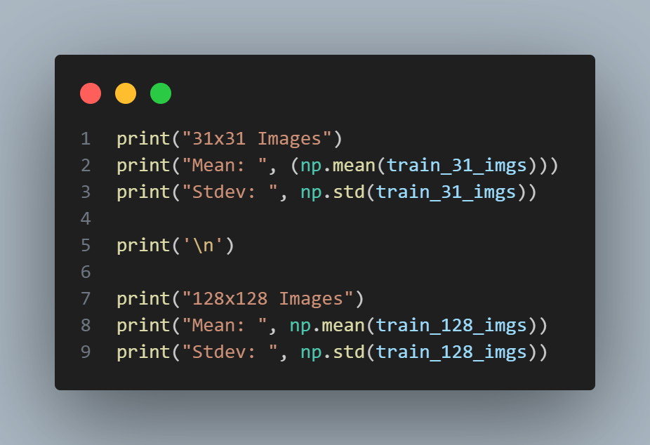
2. EDA
31x31 Images
Max: 255.0 pixels
Min: 0.0 pixels
128x128 Images
Max: 255.0 pixels
Min: 0.0 pixels
31x31 Images
Mean: 114.34133 pixels
Stdev: 55.387924 pixels
128x128 Images
Mean: 114.33357 pixels
Stdev: 55.363987 pixels

Slide 5
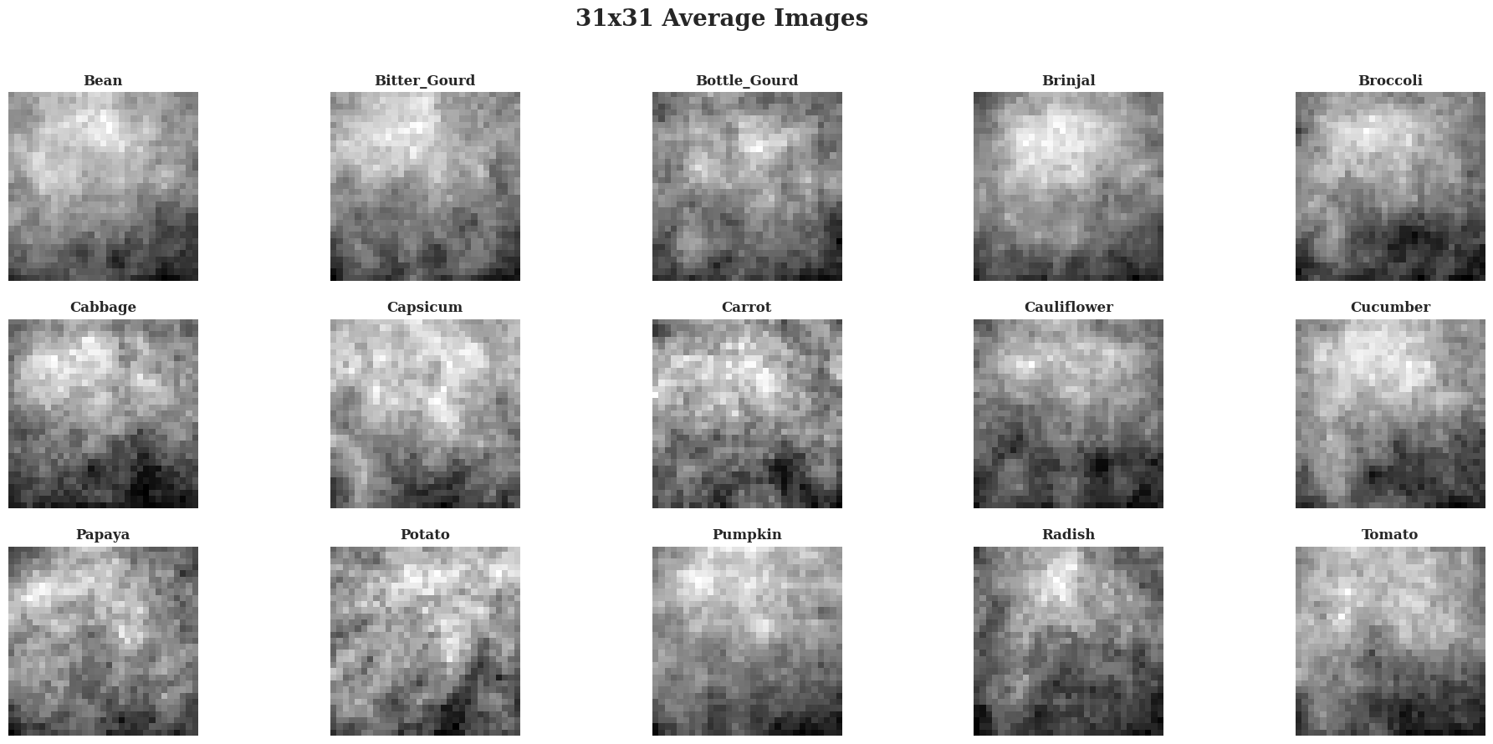
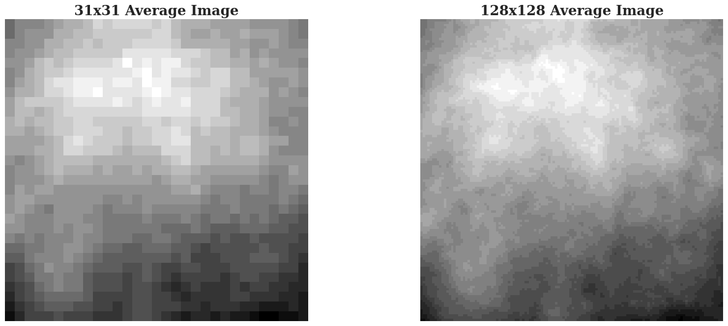
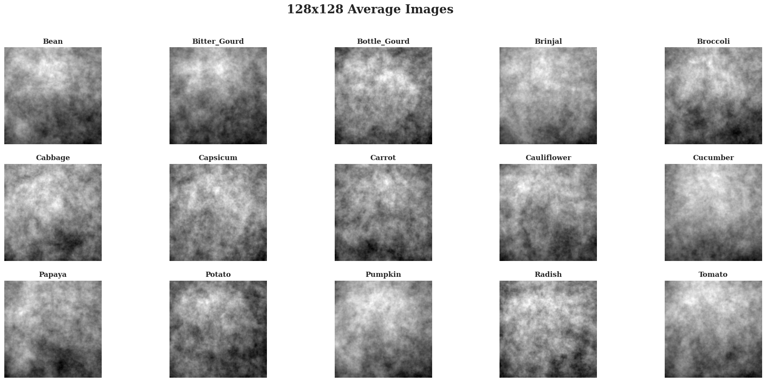
2. EDA
Image Averaging

Slide 6
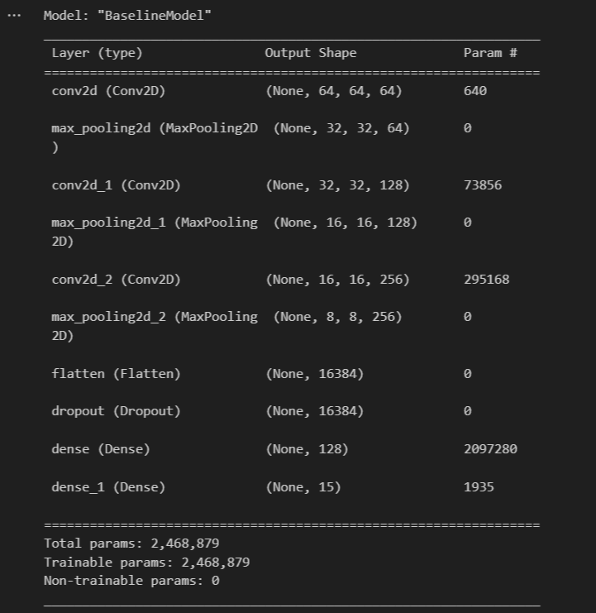
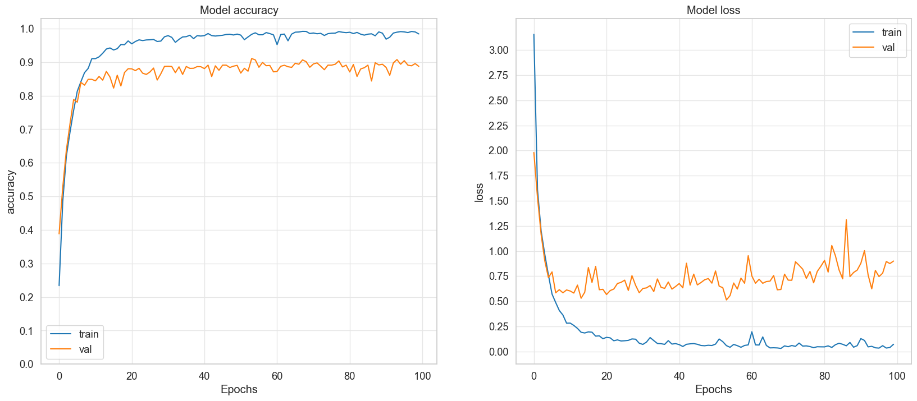
3. Model Training for 128x128 (Baseline CNN Model)

Slide 7
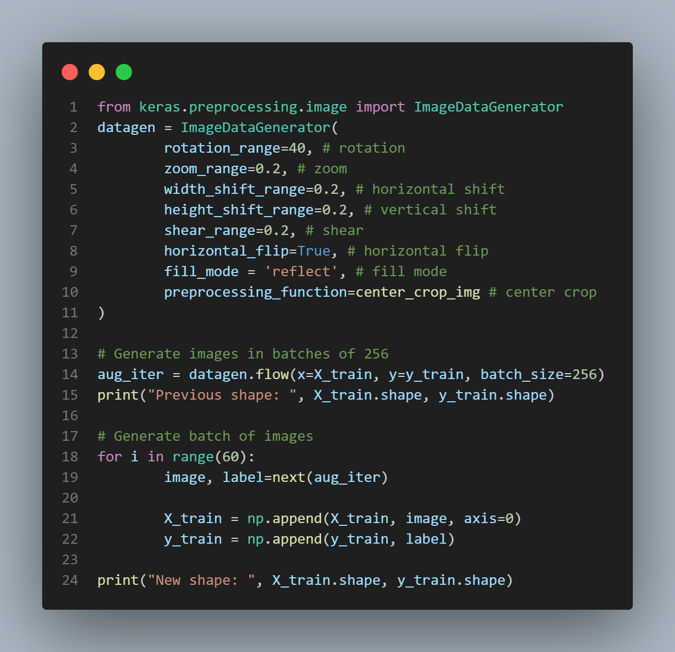
3. Model Training for 128x128 (Data Augmentation Model)
Image Data Generator
Rescale Layer
rescale = keras.Sequential(
name="data_rescaling",
layers=[
Rescaling(1.0/255), # Value Preprocessing
]
)

Slide 8
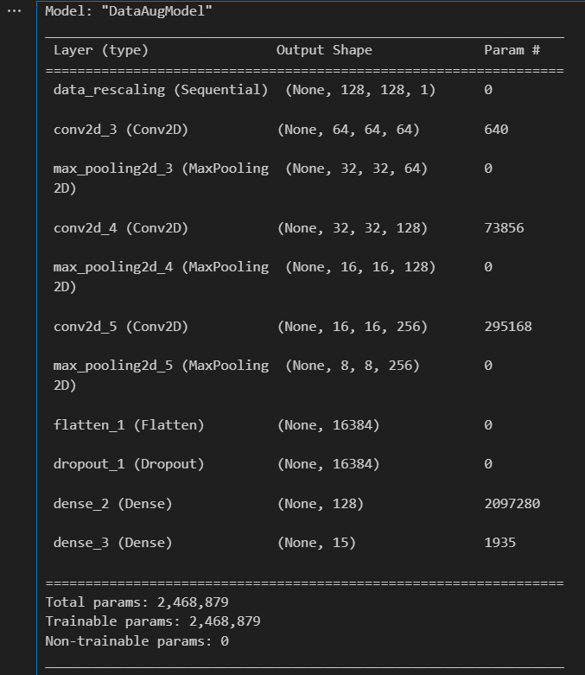
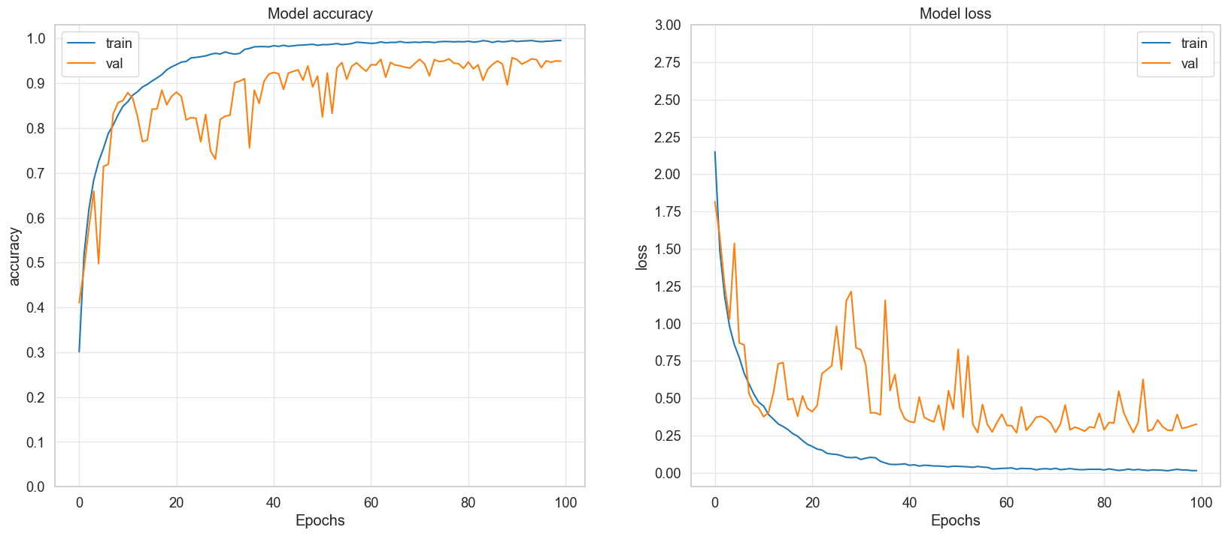
3. Model Training for 128x128 (Data Augmentation Model)

Slide 9
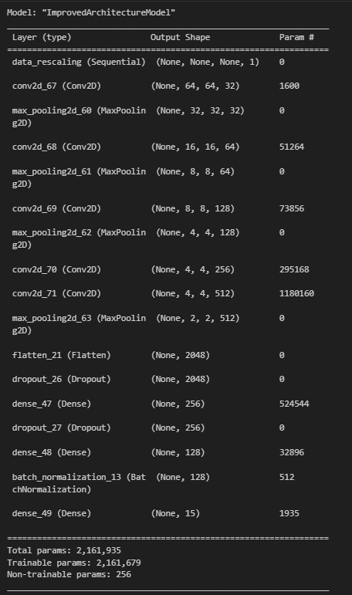
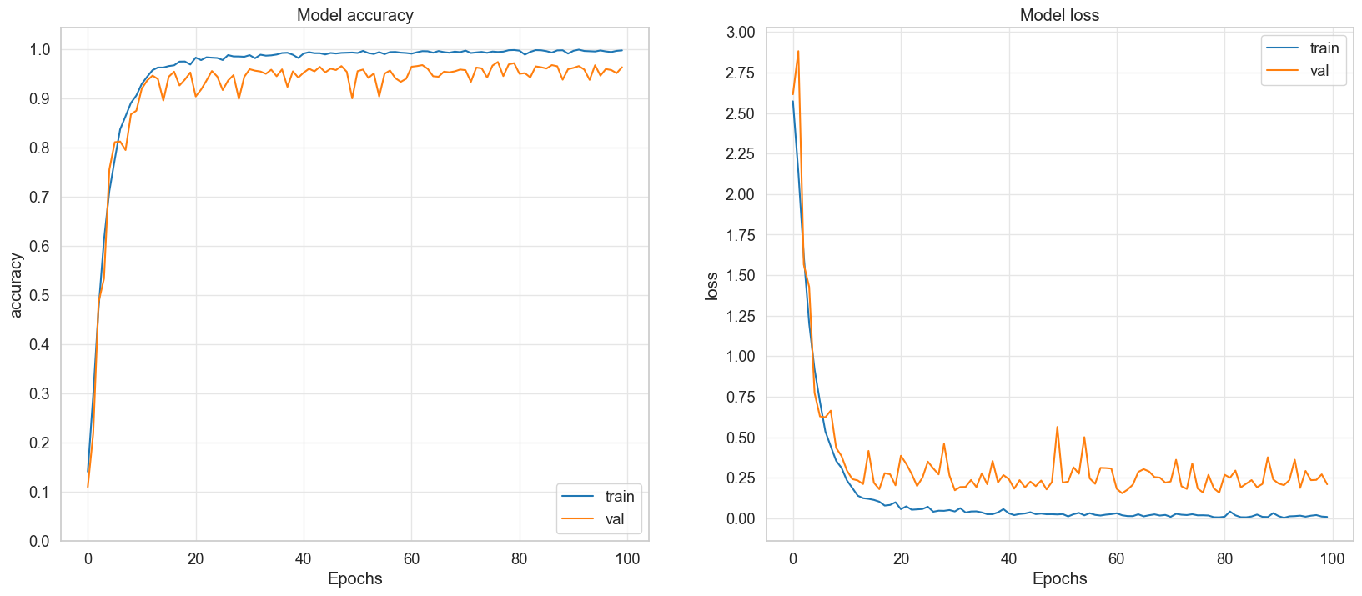
3. Model Training for 128x128 (Improved Architecture Model)

Slide 10
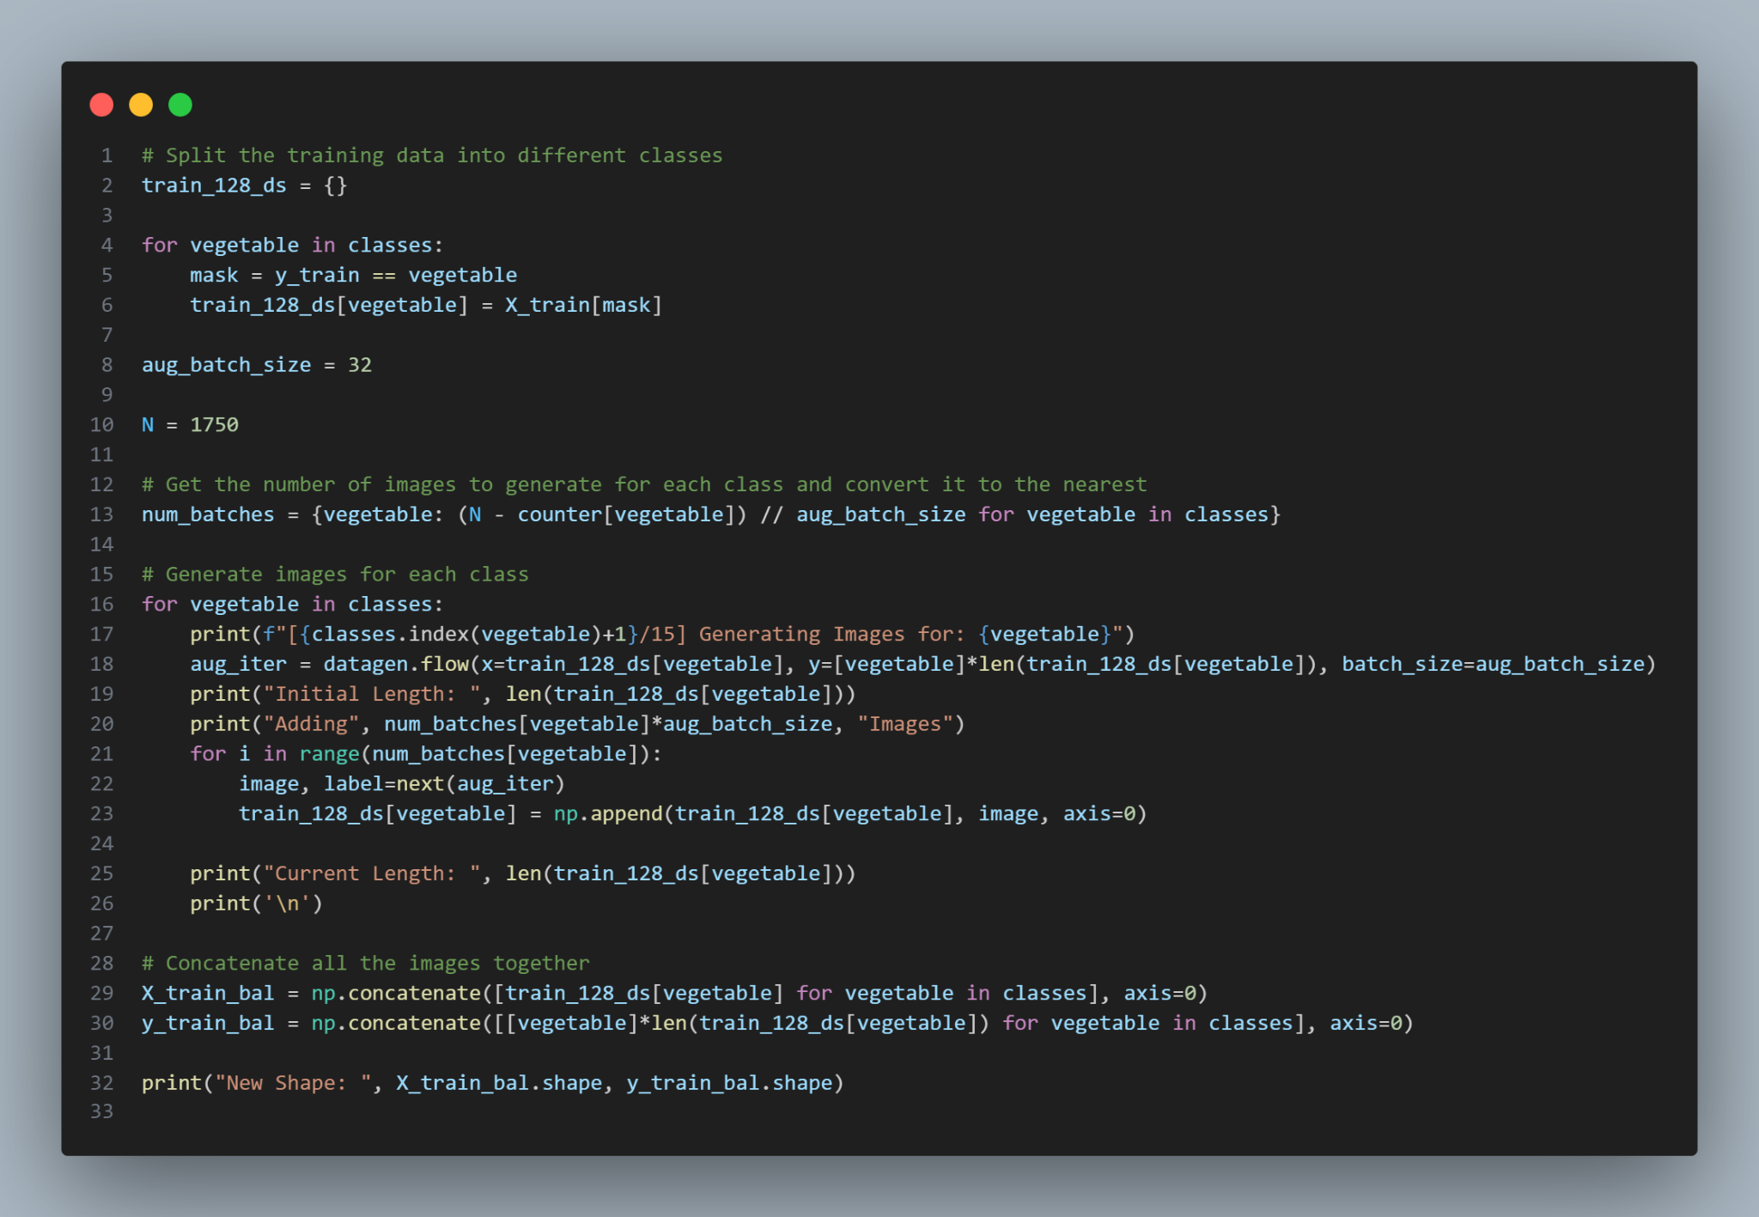
3. Model Training for 128x128 (Balanced Classes Model)
[1/15] Generating Images for: Bean
Initial Length: 780
Adding 960 Images
Current Length: 1720
[2/15] Generating Images for: Bitter_Gourd
Initial Length: 720
Adding 1024 Images
Current Length: 1728
[3/15] Generating Images for: Bottle_Gourd
Initial Length: 441
Adding 1280 Images
Current Length: 1707
...

Slide 11
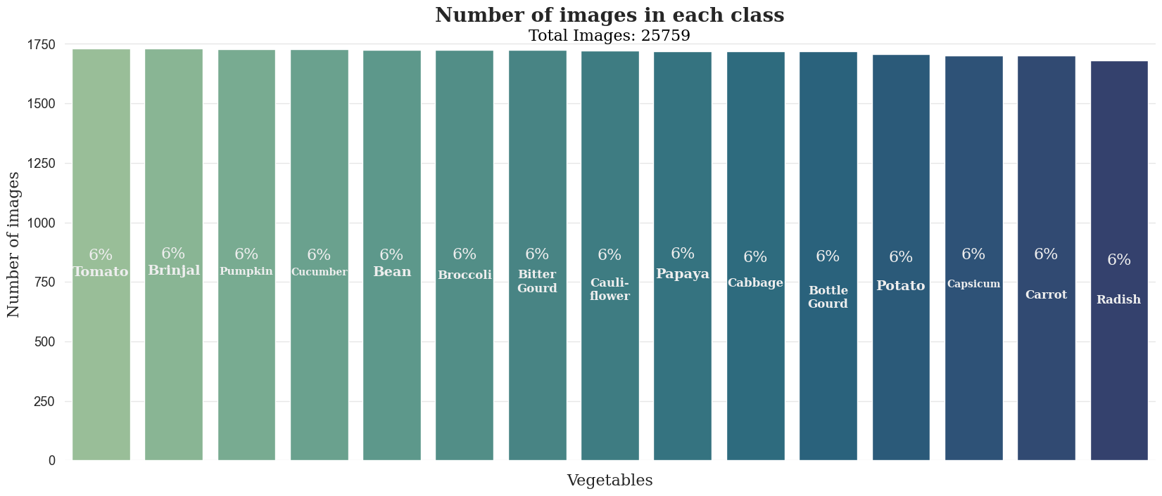
3. Model Training for 128x128 (Balanced Classes Model)
Balanced Classes

Slide 12
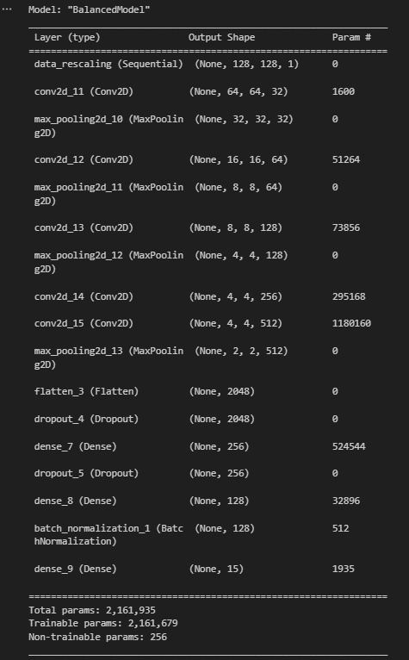
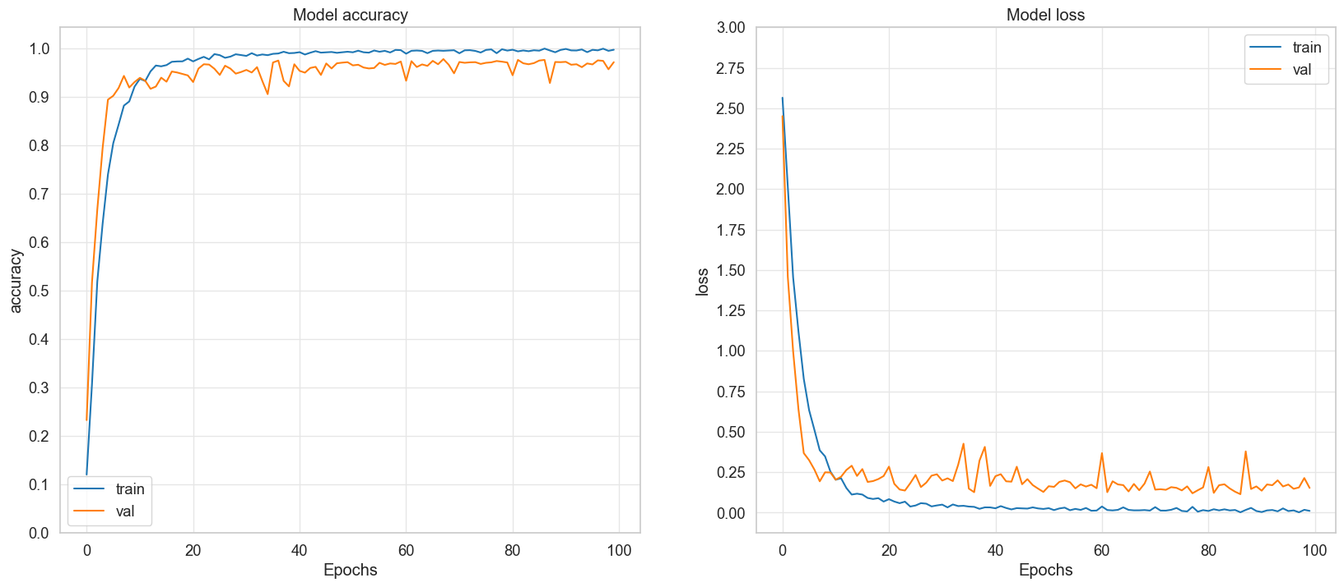
3. Model Training for 128x128 (Balanced Classes Model)

Slide 13
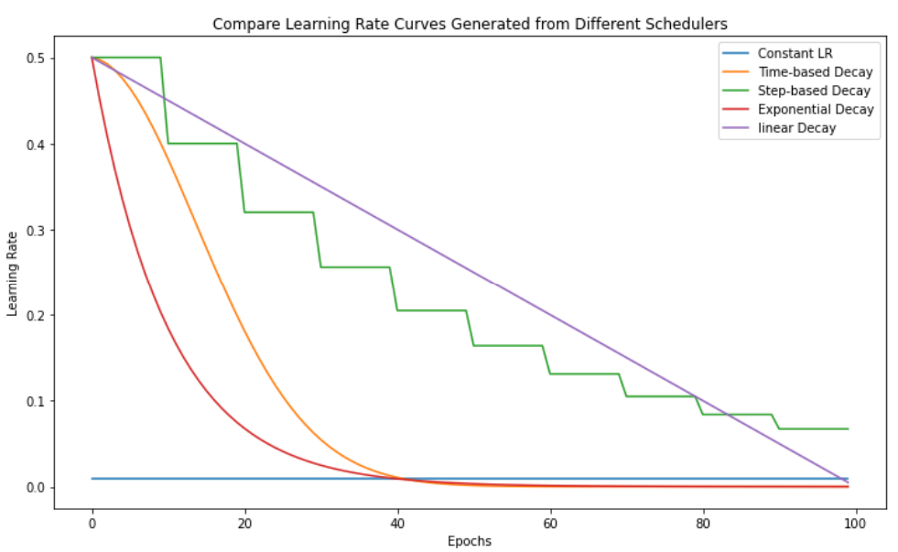
3. Model Training for 128x128 (Learning Rate Scheduler Model)
Time-Decay LR Scheduler
def timeDecay(epoch, lr):
initial_lr = 0.000_25
# Use k to speed up the decay
k = 100
# + 1 to avoid division by 0
decay = initial_lr/(epoch+1)
return lr * 1/ (1 + k * decay * epoch)
learningRateScheduler = keras.callbacks.LearningRateScheduler(timeDecay)

Slide 14
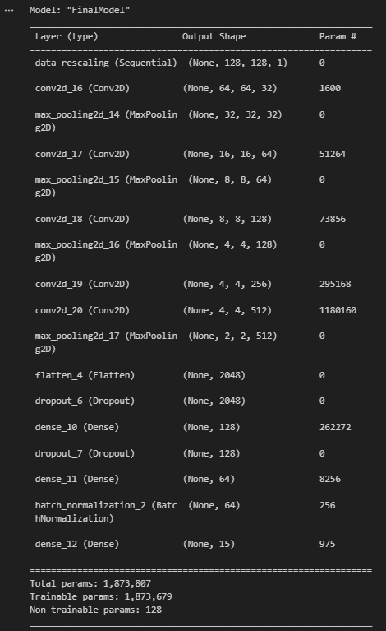
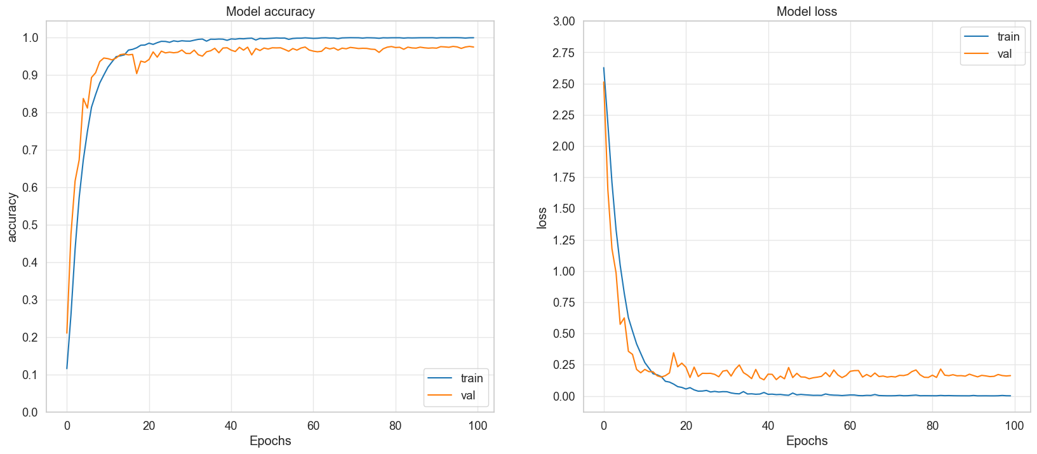
3. Model Training for 128x128 (Learning Rate Scheduler Model)

Slide 15
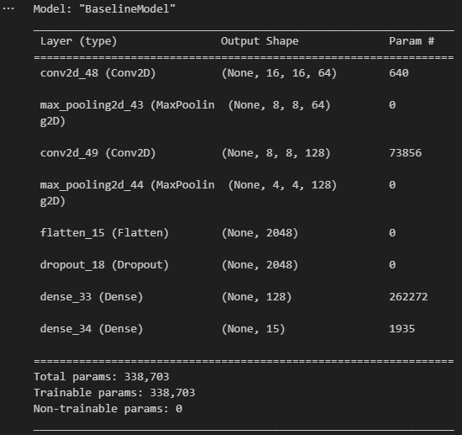
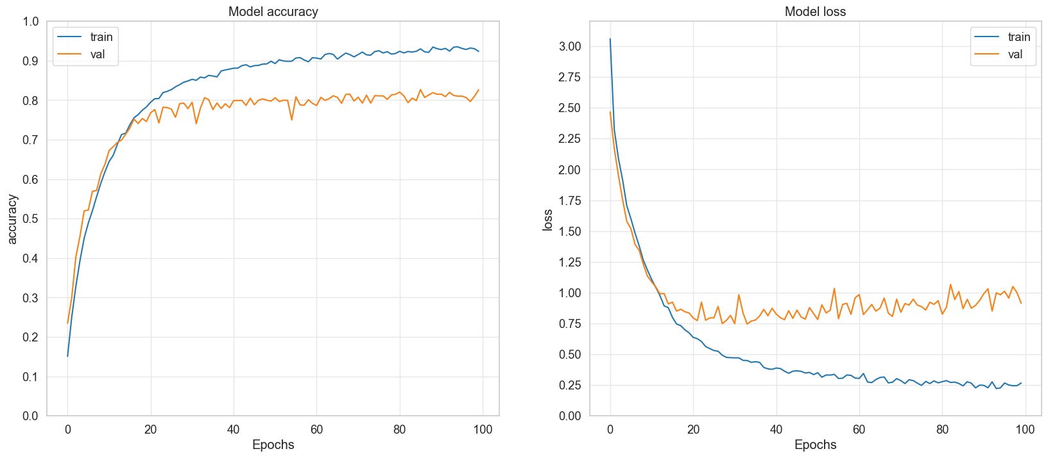
3. Model Training for 31x31 (Baseline CNN Model)

Slide 16
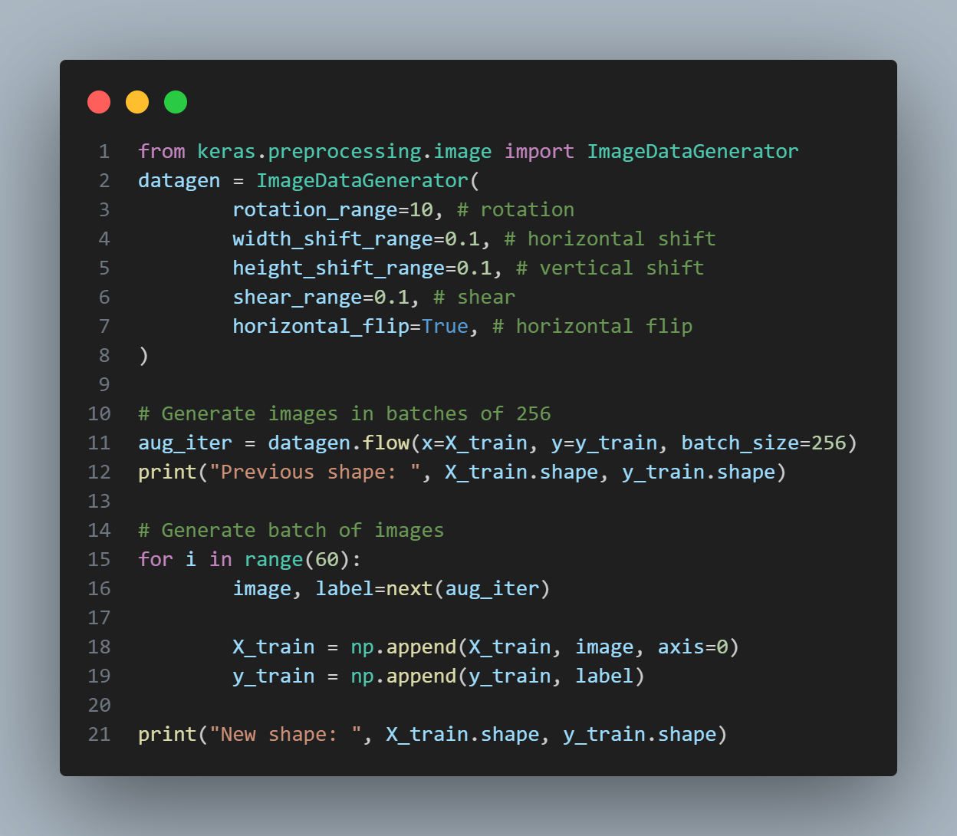
3. Model Training for 31x31 (Data Augmentation Model)
Image Data Generator
Rescale Layer
rescale = keras.Sequential(
name="data_rescaling",
layers=[
Rescaling(1.0/255), # Value Preprocessing
]
)

Slide 17
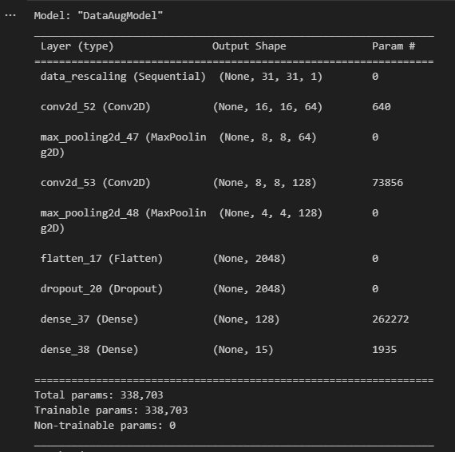
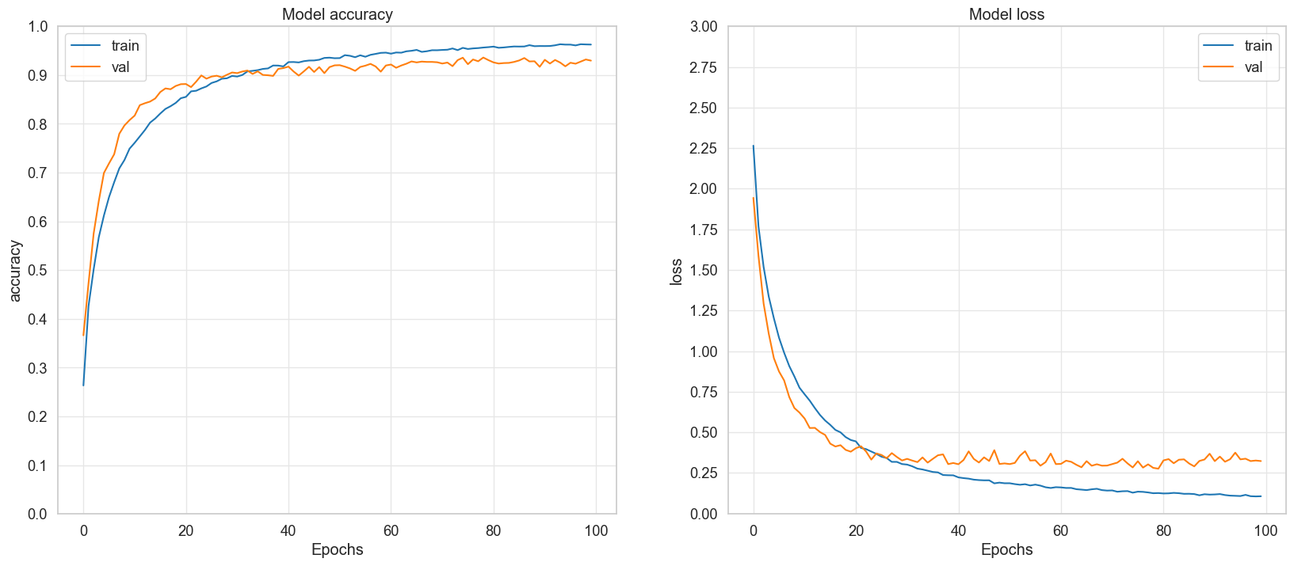
3. Model Training for 31x31 (Data Augmentation Model)

Slide 18
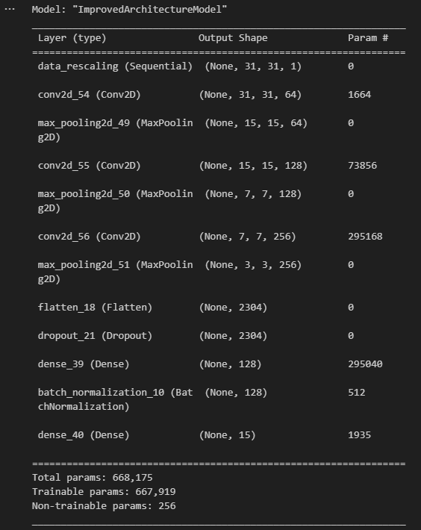
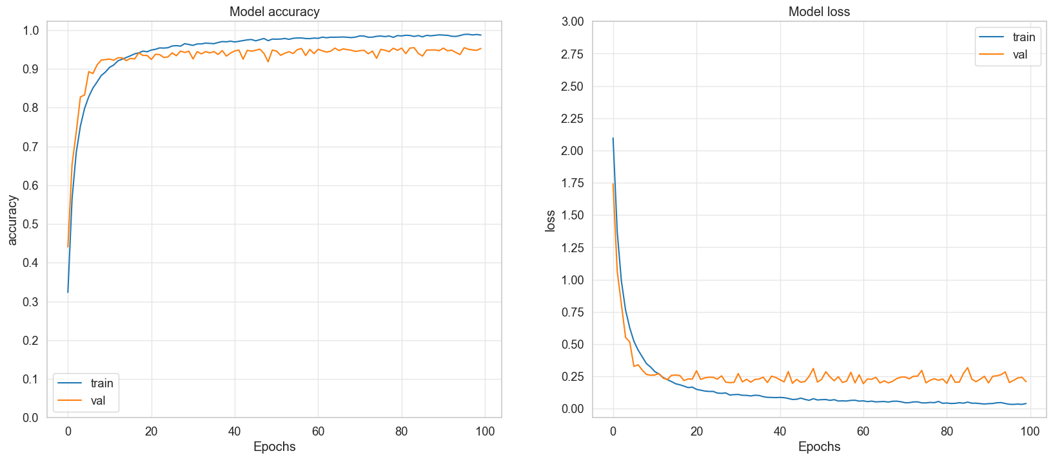
3. Model Training for 31x31 (Improved Architecture Model)

Slide 19
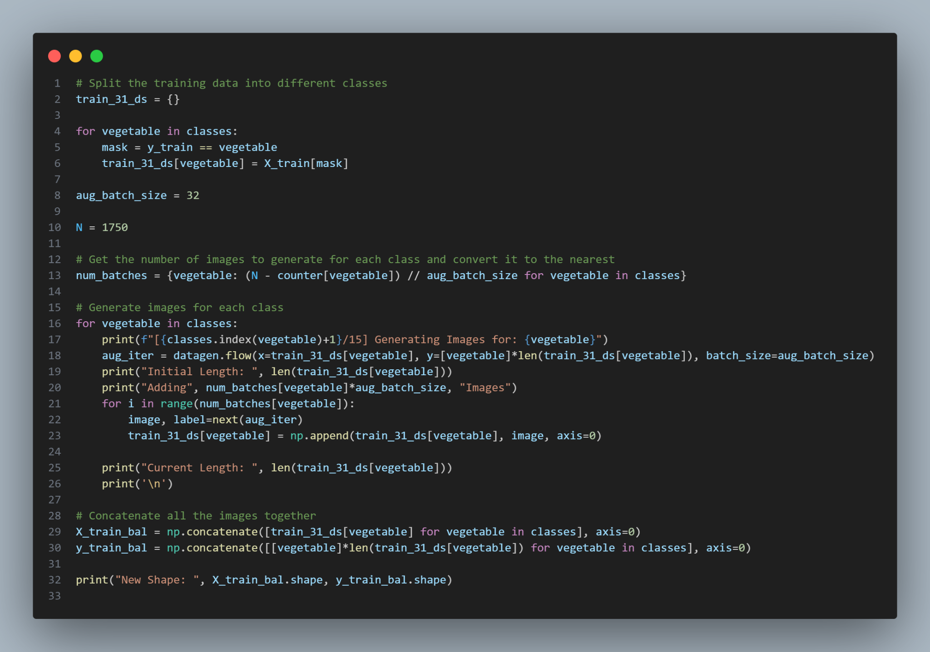
3. Model Training for 31x31 (Balanced Classes Model)
[1/15] Generating Images for: Bean
Initial Length: 780
Adding 960 Images
Current Length: 1720
[2/15] Generating Images for: Bitter_Gourd
Initial Length: 720
Adding 1024 Images
Current Length: 1728
[3/15] Generating Images for: Bottle_Gourd
Initial Length: 441
Adding 1280 Images
Current Length: 1707
...

Slide 20
3. Model Training for 31x31 (Balanced Classes Model)
Balanced Classes

Slide 21
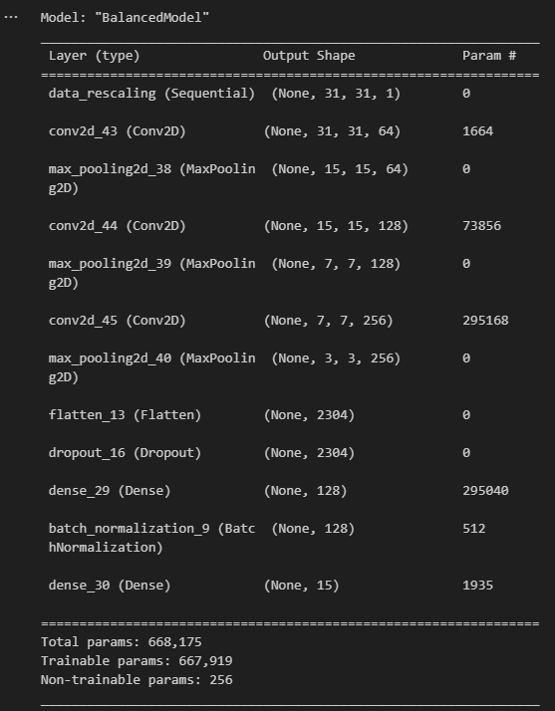
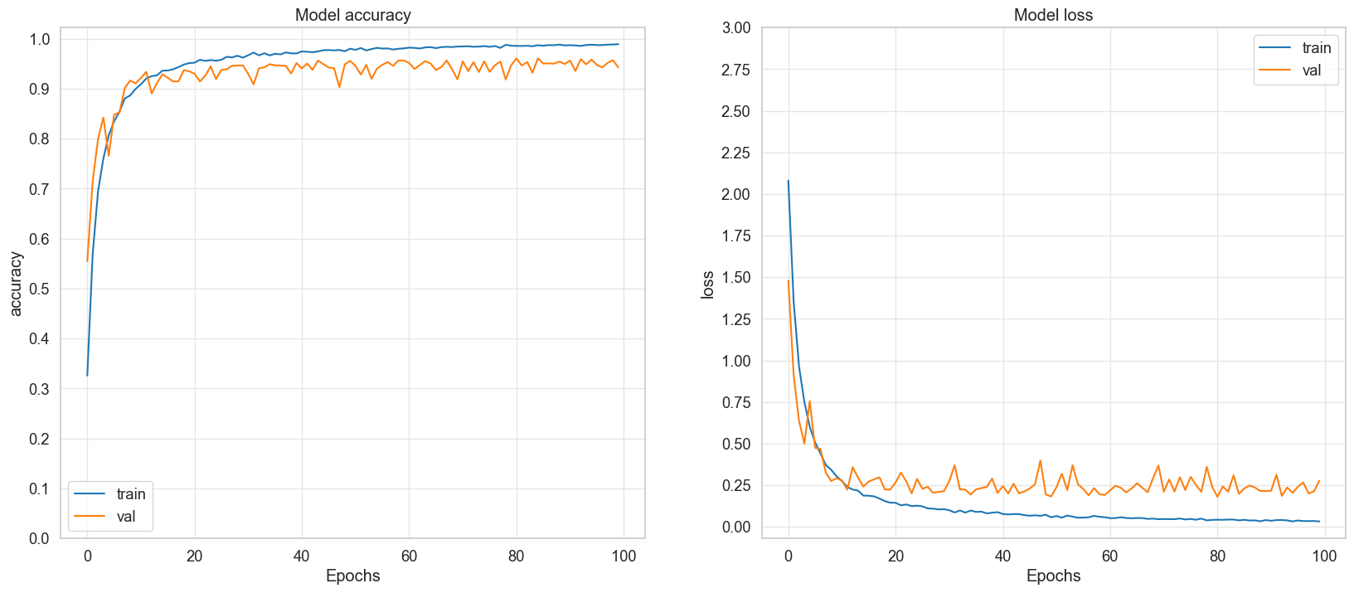
3. Model Training for 31x31 (Balanced Classes Model)

Slide 22
3. Model Training for 31x31 (Learning Rate Scheduler Model)
Time-Decay LR Scheduler
def timeDecay31(epoch, lr):
initial_lr = 0.000_25
# Use k to speed up the decay
k = 25
# + 1 to avoid division by 0
decay = initial_lr/(epoch+1)
return lr * 1/ (1 + k * decay * epoch)
learningRateScheduler31 = keras.callbacks.LearningRateScheduler(timeDecay31)

Slide 23
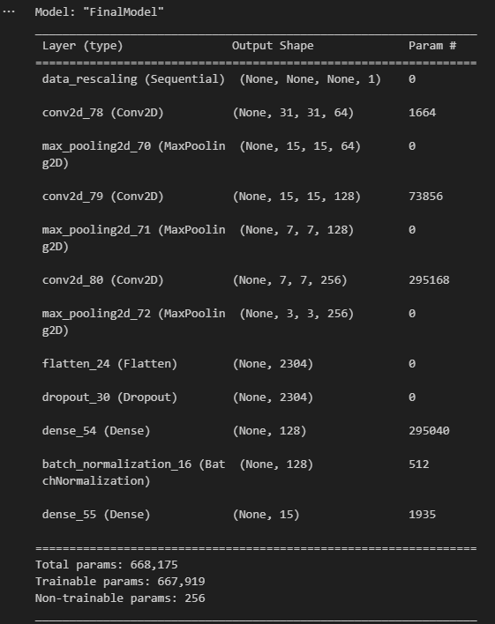
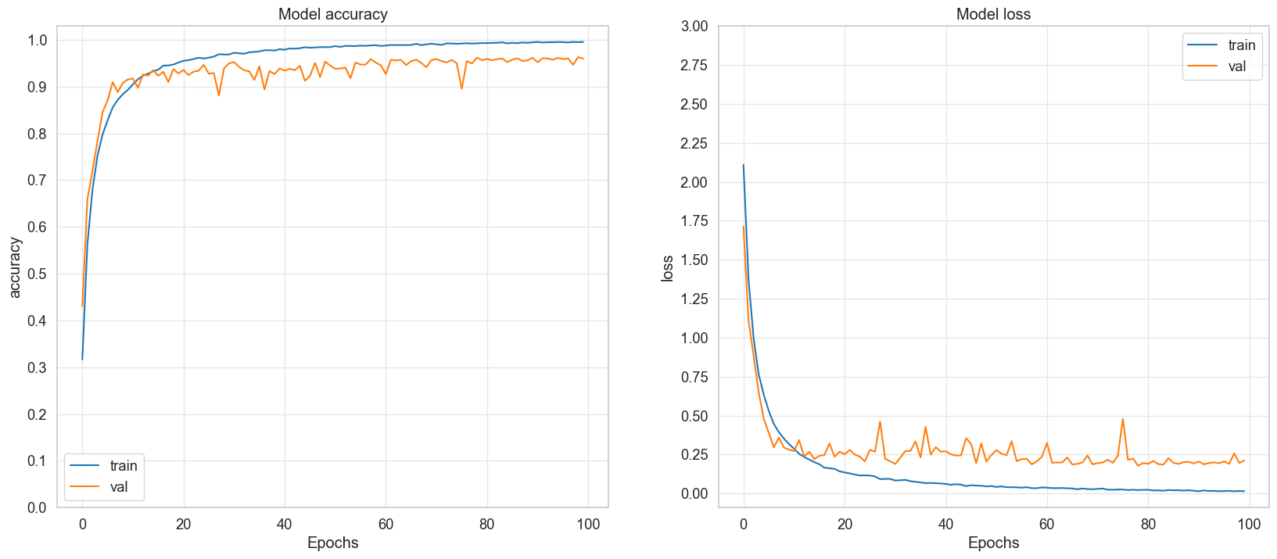
3. Model Training for 31x31 (Learning Rate Scheduler Model)

Slide 24
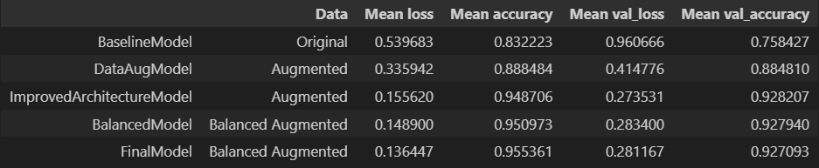
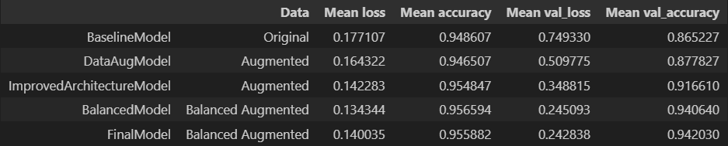
4. Model Evaluation
31x31 Model Performance
128x128 Model Performance

Slide 25
4. Model Evaluation
Evaluate Model on Test Dataset
EVALUATION FOR 128x128 MODEL
47/47 [==============================] - 1s 21ms/step - loss: 0.1464 - accuracy: 0.9710
Test Loss: 0.1464194506406784
Test Accuracy: 0.9710000157356262
-------------------------------------------------------------------------------------------
EVALUATION FOR 31x31 MODEL
94/94 [==============================] - 1s 8ms/step - loss: 0.1890 - accuracy: 0.9573
Test Loss: 0.18902982771396637
Test Accuracy: 0.9573333263397217

Slide 26
4. Model Evaluation
31x31 Classification Report
128x128 Classification Report
EVALUATION FOR 31x31 MODEL
precision recall f1-score support
Bean 0.97 0.96 0.97 200
Bitter_Gourd 0.91 0.96 0.93 200
Bottle_Gourd 0.99 0.99 0.99 200
Brinjal 0.92 0.95 0.94 200
Broccoli 0.86 0.98 0.92 200
Cabbage 0.85 0.90 0.87 200
Capsicum 0.98 0.95 0.97 200
Carrot 1.00 0.88 0.93 200
Cauliflower 0.94 0.94 0.94 200
Cucumber 0.99 0.93 0.96 200
Papaya 0.99 0.94 0.97 200
Potato 0.94 0.90 0.92 200
Pumpkin 0.86 0.95 0.90 200
Radish 1.00 0.90 0.94 200
Tomato 0.89 0.93 0.91 200
accuracy 0.94 3000
macro avg 0.94 0.94 0.94 3000
weighted avg 0.94 0.94 0.94 3000
EVALUATION FOR 128x128 MODEL
precision recall f1-score support
Bean 0.98 0.98 0.98 200
Bitter_Gourd 0.97 0.98 0.97 200
Bottle_Gourd 0.98 1.00 0.99 200
Brinjal 0.93 0.95 0.94 200
Broccoli 0.98 0.98 0.98 200
Cabbage 0.95 0.96 0.96 200
Capsicum 0.99 0.98 0.99 200
Carrot 0.99 0.96 0.98 200
Cauliflower 0.96 0.96 0.96 200
Cucumber 0.95 0.99 0.97 200
Papaya 1.00 0.98 0.99 200
Potato 0.97 0.96 0.96 200
Pumpkin 0.97 0.97 0.97 200
Radish 0.97 0.97 0.97 200
Tomato 0.97 0.92 0.94 200
accuracy 0.97 3000
macro avg 0.97 0.97 0.97 3000
weighted avg 0.97 0.97 0.97 3000

Slide 27
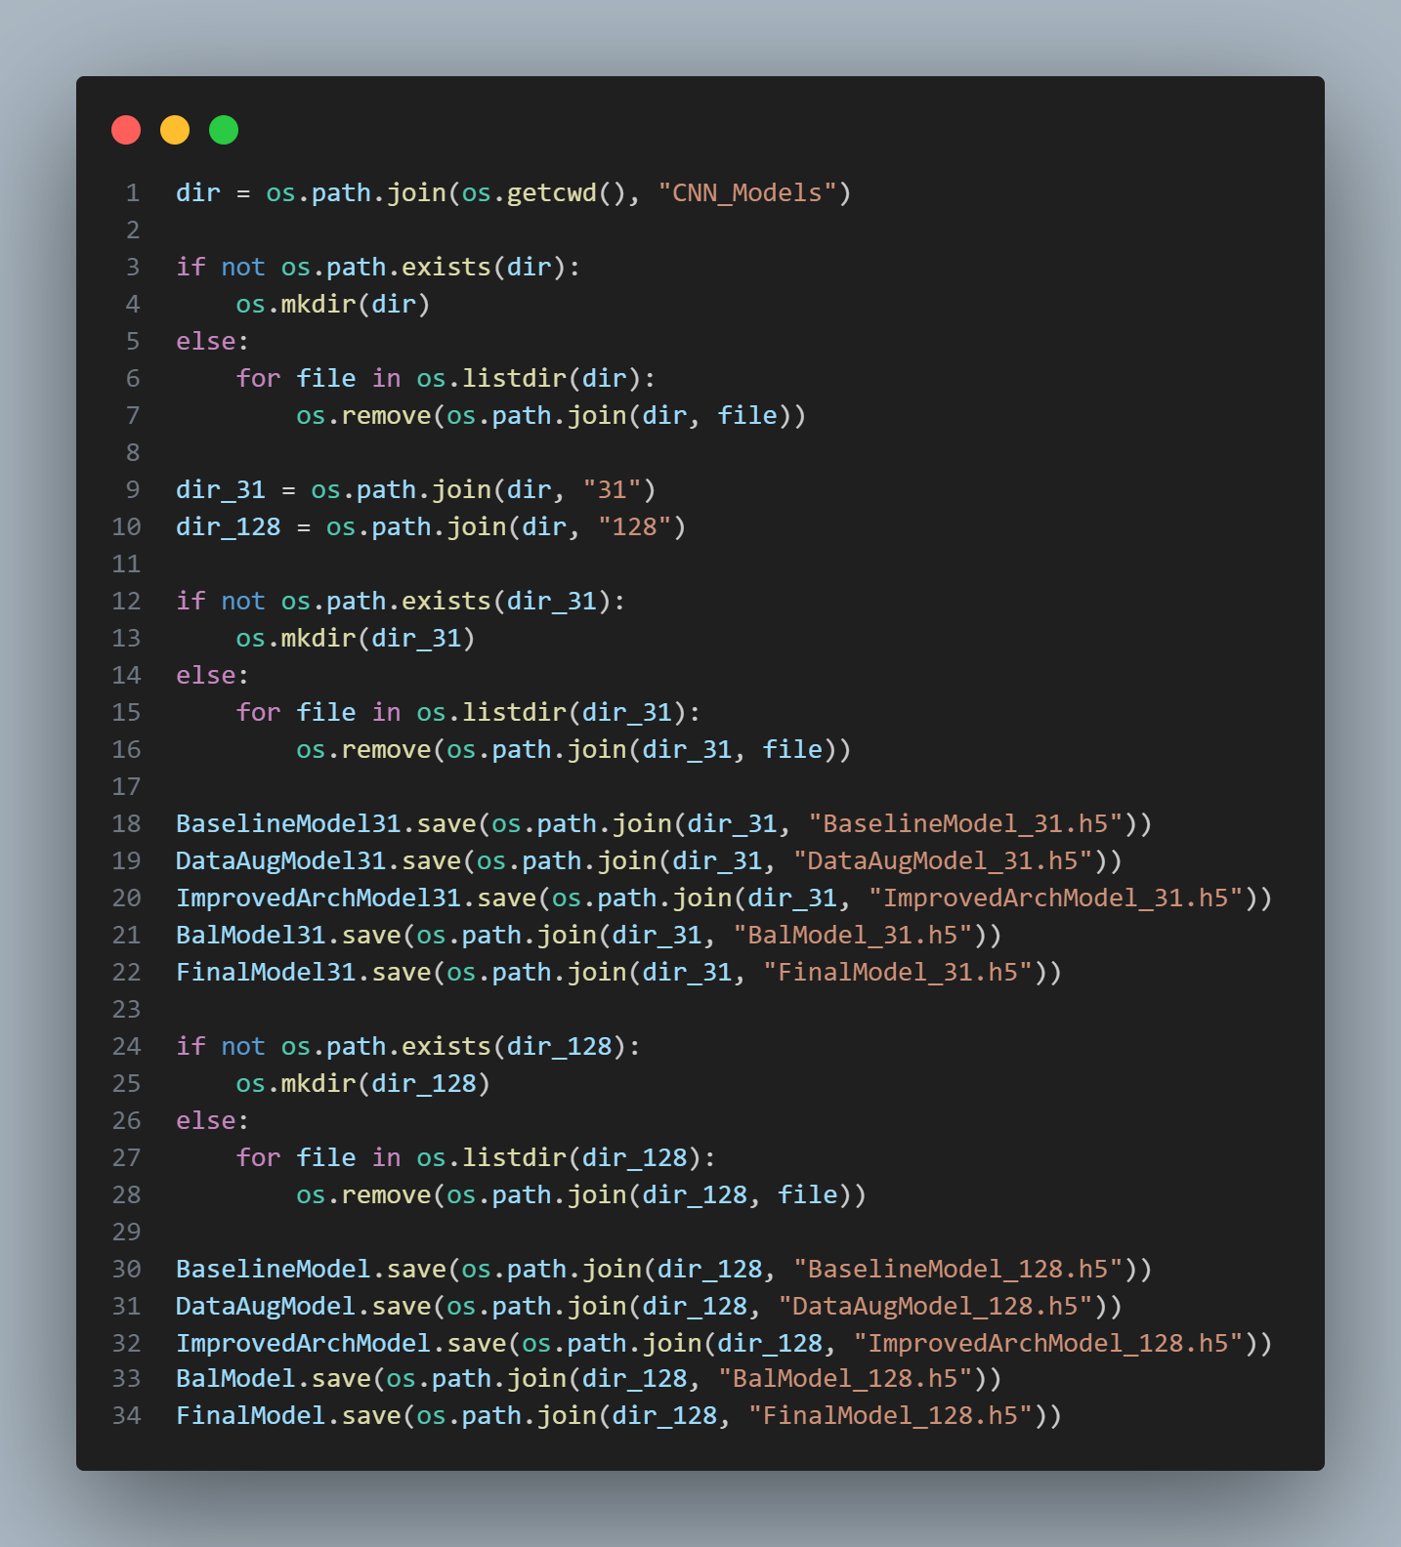
5. Saving the Model
Saving Model Weights

